Slide 1
Multiple-instance Weakly Supervised Object Localization
Defence of master thesis – 29/6/2023
Geert Goemaere

Slide 2
Content
Introduction
Research question
Methodology
Experiments
Conclusions
Notes:
Time:
10’ introduction + research method + methodology
10’ experiments + conclusions

Slide 3
Introduction

Slide 4
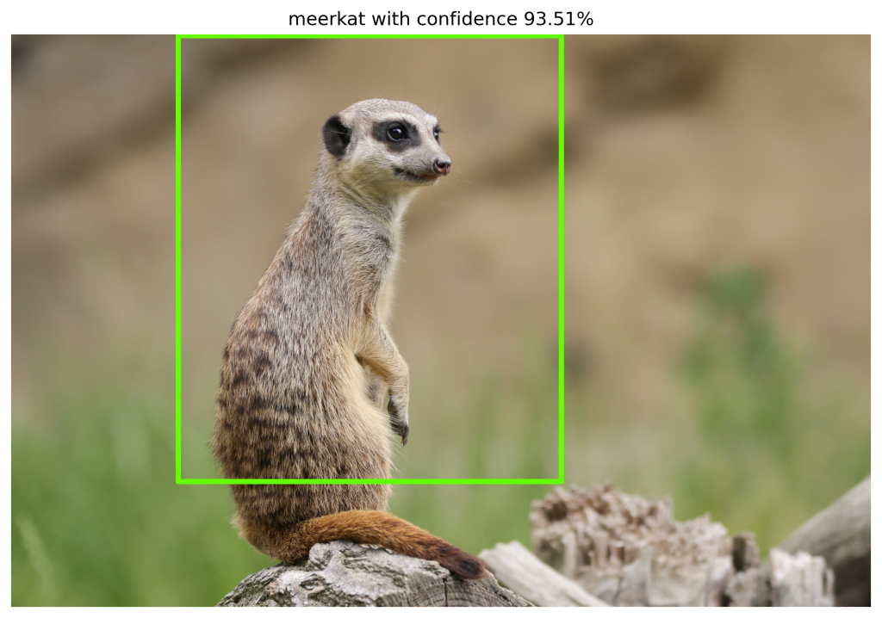
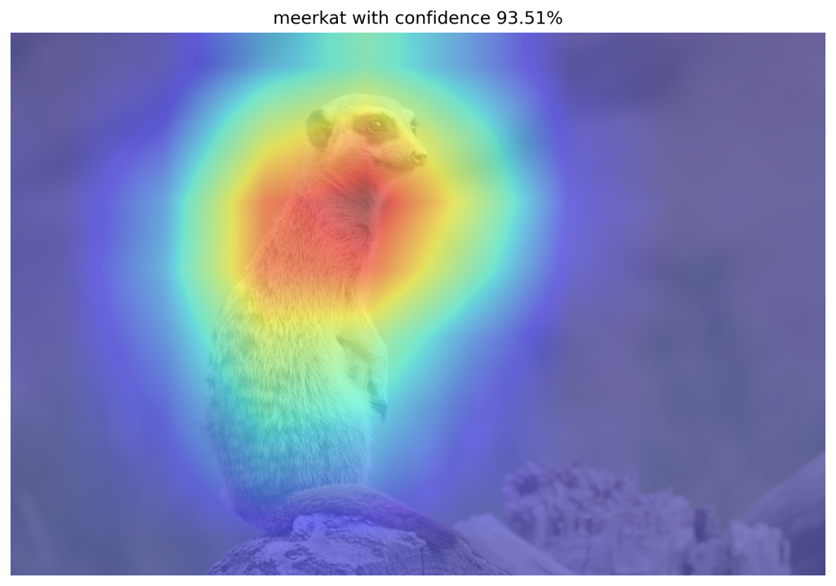
Introduction
CAM-based WSOL methods
Class Activation Mapping (CAM) [1]
Identifies discriminative image regions important for classification
Binarized CAM is used to localize object
CAM-based techniques to improve CAM
Grad-CAM [2], Grad-CAM++ [3], Score-CAM [4],
MinMaxCAM [5]
Problem
Multiple-instance localization hasn’t been tested in prior-art
No existing evaluation protocol

Slide 5
Research question

Slide 6
Research question
Can we use CAM-based methods to evaluate and improve
localization of multiple object instances of the same class
within images for the WSOL task?

Slide 7
Research question - contributions
Can we use CAM-based methods to evaluate and improve
localization of multiple object instances of the same class
within images for the WSOL task?
protocol
Iterative localization
Synthetic dataset

Slide 8
Methodology
Multiple-instance WSOL

Slide 9
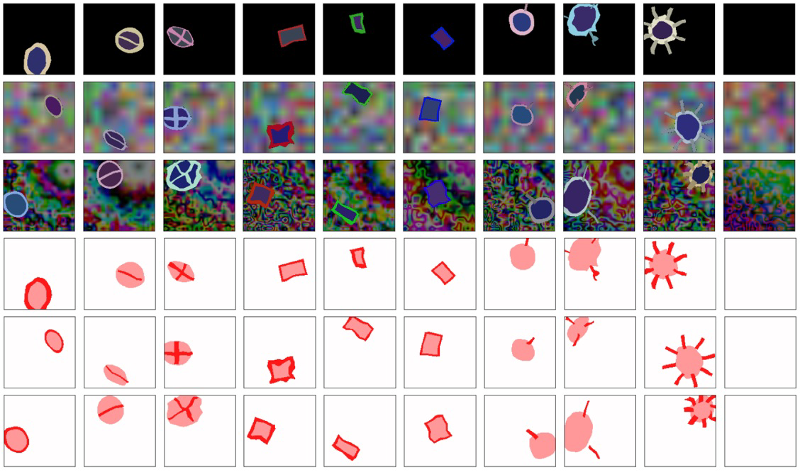
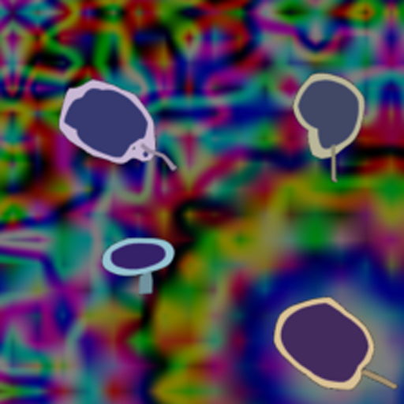
Synthetic datasets
Synthetic dataset [6]
Multiple-instance datasets
Single instance, 10 classes
GT: image-level class, segmentation mask
Multiple instances, 9 classes
GT: image-level class, segmentation mask, bounding boxes
8 datasets: E.g. d4b (4 instances on background)

Slide 10
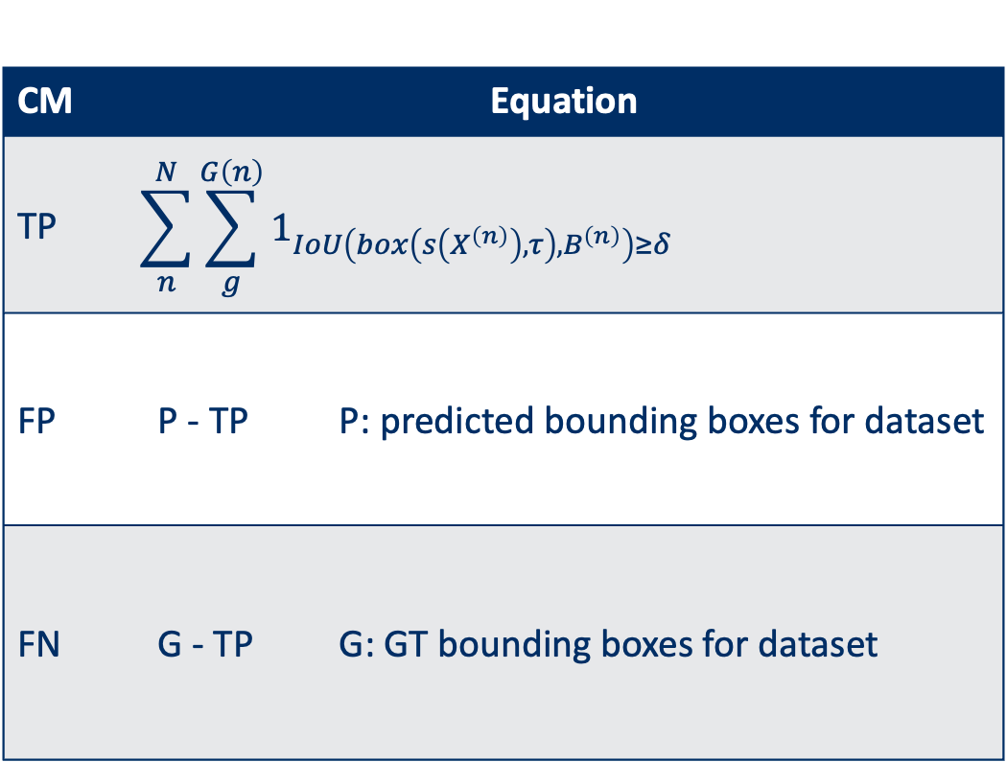
Multiple-instance localization metrics
CM | Equation
TP | $$\sum_{n}^{N}{\sum_{g}^{G\left(n\right)}{1_{IoU\left(box\left(s\left(X^{\left(n\right)}\right),τ\right),B^{\left(n\right)}\right)≥δ}}}$$
FP | P - TP | P: predicted bounding boxes for dataset
FN | G - TP | G: GT bounding boxes for dataset
GT₁
GT₂
PR₁
PR₂
GT₃
GT₄
PR₃

Slide 11
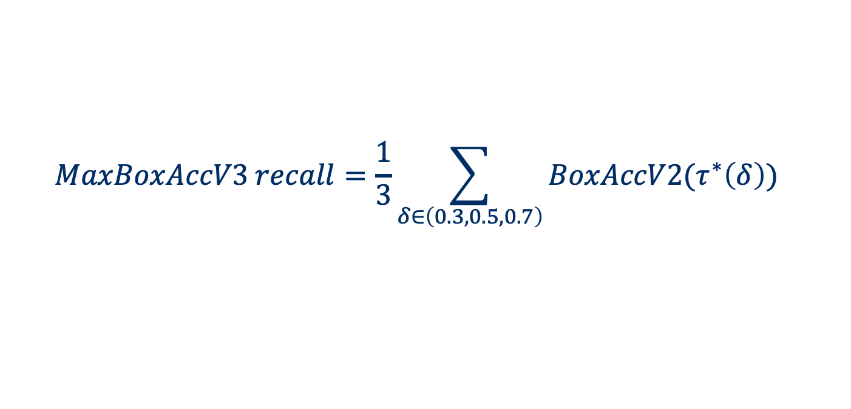
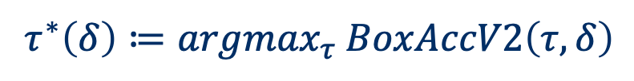
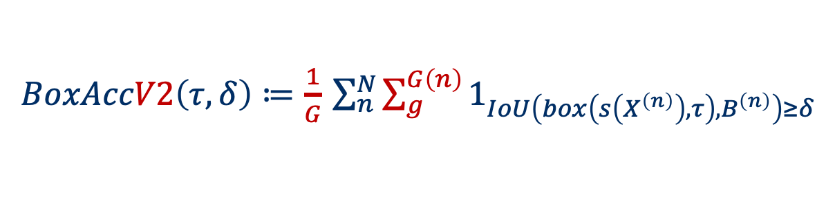
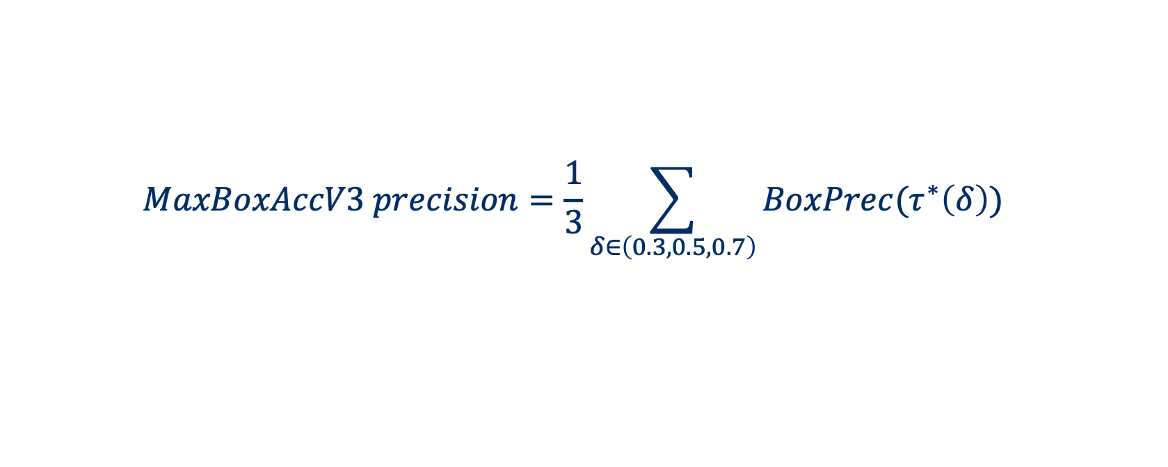
Metrics – MaxBoxAccV3 (enhanced Choe et al.[7])
TP
Recall
$BoxAccV2\left(τ,δ\right)≔\frac{1}{G}$ $\sum_{n}^{N}{\sum_{g}^{G\left(n\right)}{1_{IoU\left(box\left(s\left(X^{\left(n\right)}\right),τ\right),B^{\left(n\right)}\right)≥δ}}}$
Precision
$BoxPrec\left(τ,δ\right)≔$ $\frac{TP}{P(τ)}$
Optimal CAM threshold
$$τ^{∗}\left(δ\right)≔{argmax}_{τ} BoxAccV2\left(τ,δ\right)$$
$$MaxBoxAccV3 recall=\frac{1}{3}\sum_{δ∈\left(0.3,0.5,0.7\right)}{BoxAccV2(τ^{∗}\left(δ\right))}$$
$$MaxBoxAccV3 precision=\frac{1}{3}\sum_{δ∈\left(0.3,0.5,0.7\right)}{BoxPrec(τ^{∗}\left(δ\right))}$$
Notes:
Remark: discuss difference with BoxAcc and why BoxAcc is not applicable for multi-instance localization.

Slide 12
Localization improvement
Problem with CAM-based localization
Activations not equally strong for all object instances
Not all object instances localized

Slide 13
Iterative localization – oracle based masking
Notes:
An image is fed to the network model, and a score map is computed using a CAM-based method.
Bounding boxes are computed from the score map using various score map thresholds. Here boxes are show at the optimal threshold (MaxBoxAccV3 recall)
Oracle method: Image is masked with bounding boxes at optimal threshold (computed using GT information). Here the mask is filled with random values from image distribution in dataset.
Masked image is fed to network again, and process repeats until stop criterion is met (max iteration count or drop in prediction score higher than threshold)
Here: bbox merge strategy is ‘add’.

Slide 14
Iterative localization – score map based masking
Notes:
An image is fed to the network model, and a score map is computed using a CAM-based method.
Bounding boxes are computed from the score map using various score map thresholds. Here boxes are shown at the optimal threshold (MaxBoxAccV3 recall)
Score map method: Image is masked with score map at threshold equal to mean score map value. Here the mask is filled with random values from image distribution in dataset.
Masked image is fed to network again, and process repeats until stop criterion is met (max iteration count or drop in prediction score higher than threshold)
Here: bbox merge strategy is ‘add’.

Slide 15
Experiments

Slide 16
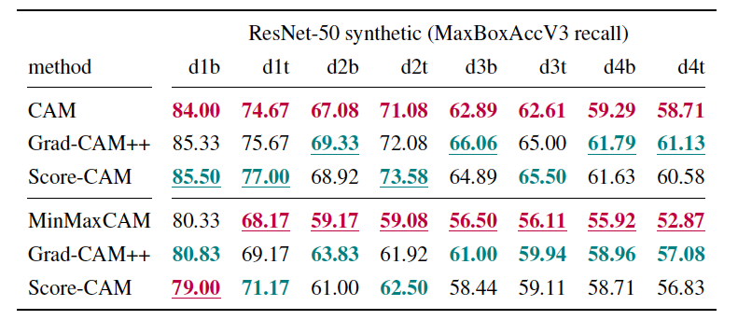
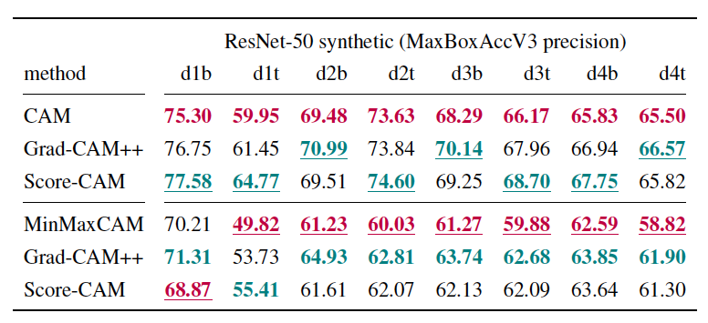
Localization: ResNet-50 - Synthetic datasets
Notes:
Trends
By colour:
Best: Grad-CAM++ and Score-CAM in nearly all datasets both for vanilla and MinMaxCAM-regularized model
Worst: CAM (more focus on discriminative features)
By instance count:
Localization performance (precision/recall) decreases as number of object instances increases in images
By regularization:
Trends from vanilla model are also found in MinMaxCAM-regularized model
Precision is better for MinMaxCAM-regularized model (less background activations)

Slide 17
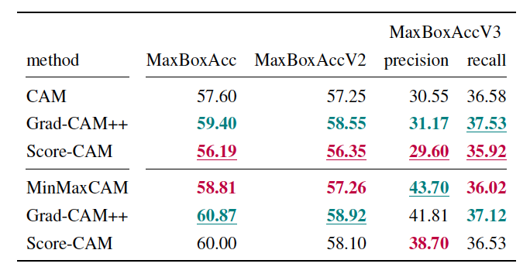
Localization: ResNet-50 - ImageNet
Notes:
Trends
By colour:
Best: Grad-CAM++ in nearly all datasets and for both non-regularized and MinMaxCAM-regularized ResNet-50 network
Worst: Score-CAM :
ImageNet is highly biased towards single-instance images, and Score-CAM doesn’t excel for single instance images.
Score-CAM produces produces more faitful explanations related to decision making process (classification) than Grad-CAM++ (less noisy than Grad-CAM++), which may not always provide the best localization performance.
By regularization:
Better recall scores for MinMaxCAM regularized scores for Score-CAM-based method, not for CAM and Grad-CAM++
Precision improves: less background activations due to CRR

Slide 18
Iterative localization: ResNet-50 for synthetic d4b
Oracle-based image masking
Score map based image masking
Notes:
Left: oracle-based iterative localizaiton, right: score map based iterative localization.
4 plots, for CAM, Grad-CAM++, Score-CAM and MinMaxCAM-regularized evaluated using CAM.
Horizontal line: baseline precision, vertical line: baseline recall. -> 4 quadrants
Recall can be improved at cost of lower precision for all CAM-based methods (oracle and score map)
Mask strategy less important (more clustered per merge strategy)
Merge strategy important: add strategy best for recall, worst for precision
Grad-CAM++ and Score-CAM can obtain highest gain in recall
Score map results are lower than oracle results
Average score map value threshold less accurate than oracle threshold (GT)
Simple structure of synthetic datasets: cleanly separated instances

Slide 19
Iterative localization: ResNet-50 – Synthetic (oracle)
Notes:
Qualitative examples

Slide 20
Iterative localization: ResNet-50 – Synthetic (score map)
Notes:
Qualitative examples

Slide 21
Iterative localization: ResNet-50 for ImageNet
Oracle
based
Score map
based
Notes:
Discuss trends:
Recall increases, precision drops
Mask strategy less important
Merge strategy important
Recall trend score map approach higher than oracle-based approach
In contrast with synthetic datasets
Intuition:
ImageNet more complex structure: No clean separationof object instances
Very diverse set of images.
Bounding box masks: Optimal threshold is tuned towards maximizing matches with GT

Slide 22
Iterative localization: ResNet-50 – ImageNet (oracle)
Notes:
Qualitative example

Slide 23
Iterative localization: ResNet-50 – ImageNet (score map)
Notes:
Qualitative example

Slide 24
Conclusions

Slide 25
Conclusions
Multiple-instance WSOL evaluation
Validated for synthetic and ImageNet on VGG16 and ResNet-50
Localization performance is correlated with number of object instances
Individual localization of multiple instances depends on image structure
Improvements using iterative localization
Masking technique to find new objects
Localization recall can be improved at cost of precision
Individual instance localization difficult for neighboring objects
Limitations of WSOL task trained for classification only
CAM-based WSOL methods can be used to evaluate and improve
multiple-instance localization

Slide 26
References
[1] Bolei Zhou, Aditya Khosla, Agata Lapedriza, Aude Oliva, and Antonio Torralba. Learning deep features for discriminative localization. In Computer Vision and Pattern Recognition, 2016.
[2] Ramprasaath R Selvaraju, Michael Cogswell, Abhishek Das, Ramakrishna Vedantam, Devi Parikh, and Dhruv Batra. Grad-cam: Visual explanations from deep networks via gradient-based localization. In Proceedings of the IEEE international conference on computer vision, pages 618–626, 2017.
[3] Aditya Chattopadhay, Anirban Sarkar, Prantik Howlader, and Vineeth N Balasubramanian. Grad-cam++: Generalized gradient-based visual explanations for deep convolutional networks. In 2018 IEEE winter conference on applications of computer vision (WACV), pages 839–847. IEEE, 2018.
[4] Haofan Wang, Zifan Wang, Mengnan Du, Fan Yang, Zijian Zhang, Sirui Ding, Piotr Mardziel, and Xia Hu. Score-cam: Score-weighted visual explanations for convolutional neural networks. In Proceedings of the IEEE/CVF conference on computer vision and pattern recognition workshops, pages 24–25, 2020.
[5] KailiWang, Jose Oramas, and Tinne Tuytelaars. Minmaxcam: Improving object coverage
for cam-basedweakly supervised object localization. arXiv preprint arXiv:2104.14375, 2021.
[6] Erico Tjoa and Guan Cuntai. Quantifying explainability of saliency methods in deep neural networks with a synthetic dataset. IEEE Transactions on Artificial Intelligence, 2022.
[7] Junsuk Choe, Seong Joon Oh, Seungho Lee, Sanghyuk Chun, Zeynep Akata, and Hyunjung Shim. Evaluating weakly supervised object localization methods right. In Proceedings of the IEEE/CVF Conference on Computer Vision and Pattern Recognition, pages 3133–3142, 2020.

Slide 27



Slide 28
Backup

Slide 29

Multiple-instance WSOL
WSOL
Multiple-instance WSOL
Notes:
The research topic of this thesis is called “multiple-instance weakly supervised object localization” (multiple-instance WSOL).
So, let’s first explain where in the object recognition landscape whe can situate multi-instance WSOL by looking at different tasks in this picture.
Image classification deals with assigning a single label or category) to an image. Here the label is CAT.
Object localization deals with localizing objects in an image by indicating their bounding box. In the case of WSOL, only a single object is localized by training a model with class labels only.
Object detection is the task of locating objects in an image with bounding boxes and assigning a class label for each detection.
Instance segmentation deals with assigning a class label for each pixel of an image.
Just as WSOL, multi-instance WSOL uses only class labels to train a model for localization, but it extends WSOL to find mutiple objects of the same class.

Slide 30
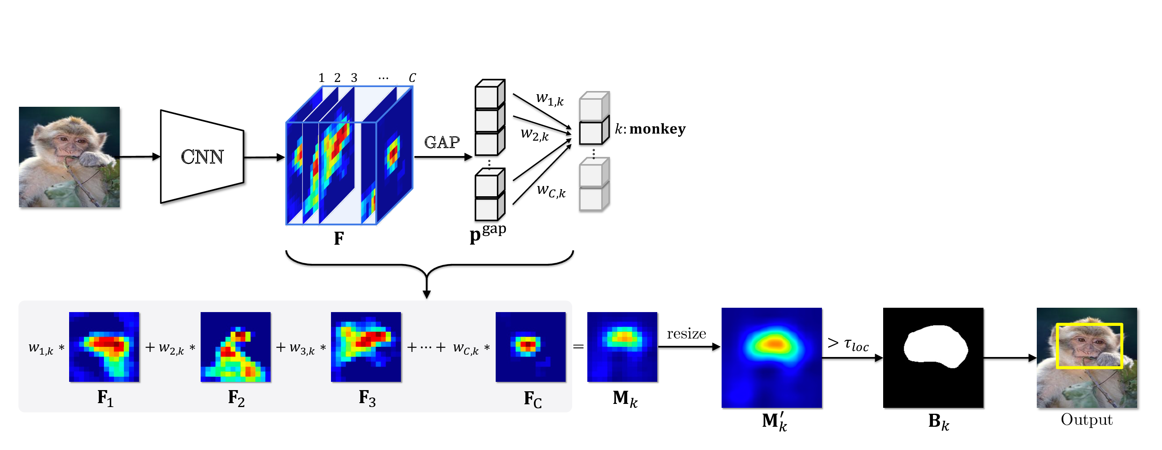
CAM-based WSOL
Notes:
Classifier is trained using image-level class labels
Activation map = weighted (*) combination of feature maps
Binary mask = Activation map > threshold 𝛕
Predicted bounding boxes are computed from contours in binary mask
(*) Weight computation is specific to CAM-based method

Slide 31
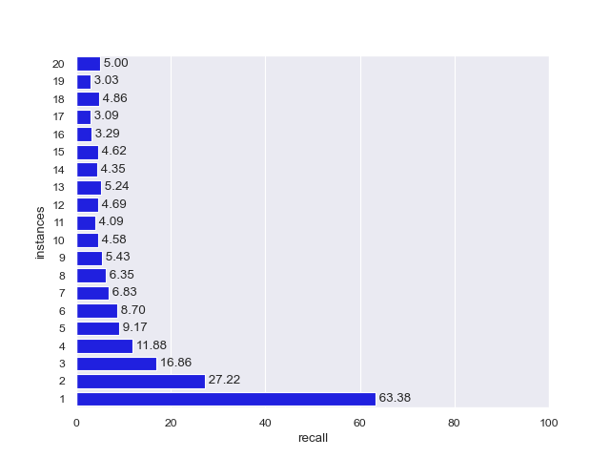
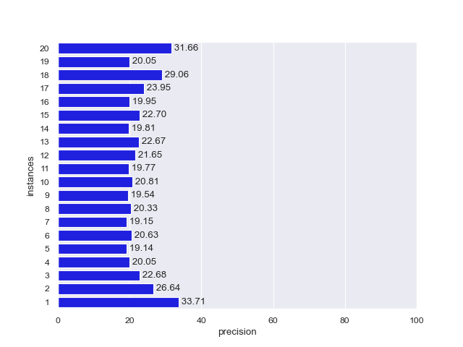
Localization: ResNet-50 - ImageNet
CAM - MaxBoxAccV3 recall: 36.58
CAM - MaxBoxAccV3 precision: 30.55
Notes:
Recall is highest for the single-instance dataset, and significantly drops significantly as more object instances are present in the images of a dataset.
For ImageNet datasets with eight or more instances, recall seems to be rather similar.
Overall recall for singe ImageNet dataset was: 0.38
We observed a similar pattern for the synthetic: recall decreases for images with more instances.

Slide 32
Localization: ResNet-50 - Synthetic dataset d1b (vanilla vs MinMaxCAM)
MinMaxCAM
Notes:
By method
Grad-CAM++ best, Score-CAM worst (not particularly excelling for single-instance images)
By regularization
- MinMaxCAM worse than non-regularized (not show at same threshold)

Slide 33
Localization: ResNet-50 - Synthetic dataset d4b (vanilla vs MinMaxCAM)
Vanilla
MinMaxCAM
Notes:
By method
Grad-CAM++ best, Score-CAM worst
By regularization
- MinMaxCAM worse than non-regularized (not show at same threshold)

Slide 34
Localization: ResNet-50 – ImageNet (vanilla vs MinMaxCAM)
Notes:
Regularization effect: less background activations.

Slide 35
Localization: ResNet-50 – ImageNet (vanilla vs MinMaxCAM)
Notes:
Regularization effect: less background activations.

Slide 36
Localization: ResNet-50 – ImageNet (vanilla vs MinMaxCAM)
Notes:
Regularization effect: less background activations.

Slide 37
Iterative localization: ResNet-50 – ImageNet (oracle)

Slide 38
Iterative localization: ResNet-50 – ImageNet (score map)

Slide 39
Iterative localization: ResNet-50 – ImageNet (oracle)
Notes:
Qualitative example

Slide 40
Iterative localization: ResNet-50 – ImageNet (score map)
Notes:
Qualitative example

Slide 41
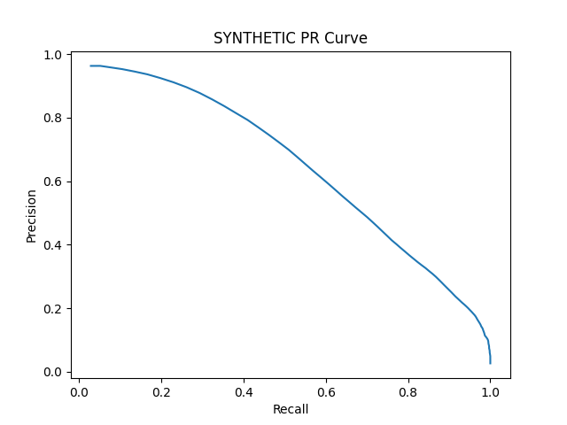
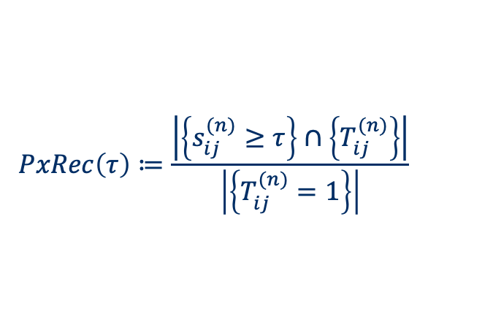
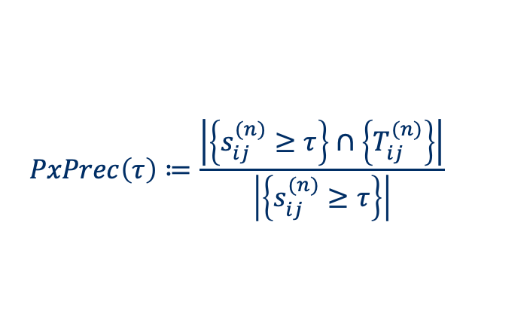
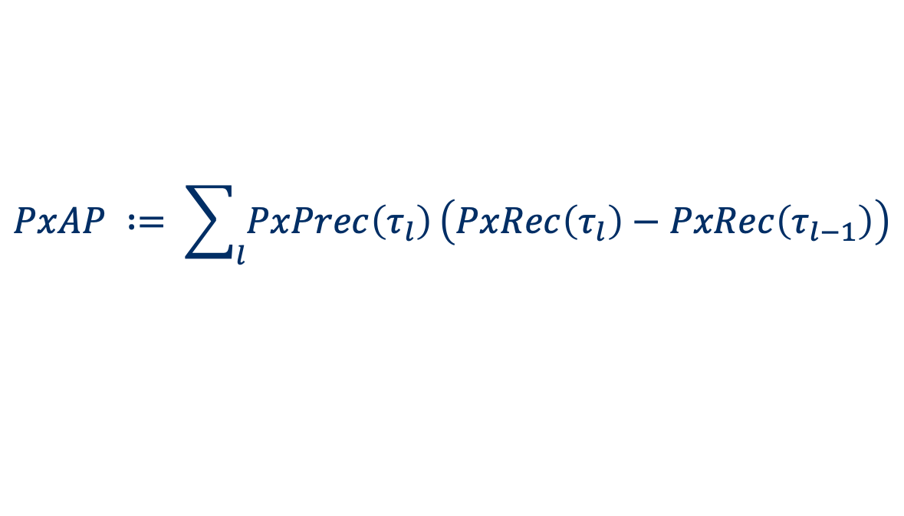
Metrics – Pixel Average Precision (PxAP)
PxAP already used in [Choe et al., 2020b]
Applies to multi-instance localization
Only usable when GT segmentation masks available
$$PxPrec\left(τ\right)≔\frac{\left|\left\{s_{ij}^{(n)}≥τ\right\}\right.∩\left.\left\{T_{ij}^{(n)}\right\}\right|}{\left|\left\{s_{ij}^{(n)}≥τ\right\}\right|}$$
$$PxRec\left(τ\right)≔\frac{\left|\left\{s_{ij}^{(n)}≥τ\right\}\right.∩\left.\left\{T_{ij}^{(n)}\right\}\right|}{\left|\left\{T_{ij}^{(n)}=1\right\}\right|}$$
$$PxAP ∶= \sum_{l}{PxPrec\left(τ_{l}\right)}\left(PxRec\left(τ_{l}\right)−PxRec\left(τ_{l−1}\right)\right)$$
Notes:
Remark: keep as backup slide

Slide 42
Learning curves
Observations
Example: MinMaxCAM for VGG16-GAP SYNTHETIC
Best localization after few training epochs
Further classification training hurts localization
Focus on most discriminative parts
In line with Choe et al, 2020b findings

Slide 43
Box Accuracy at varying CAM thresholds (IOU 50)
Notes:
BoxAcc for 1, 2, 3, 4 instance datasets
1 instance: All CAM methods perform similarly, outperformed by ScoreCAM
2,3,4: ScoreCAM performance margin over others even more pronounced
Optimal CAM threshold similar for all methods

Slide 44
Precision-Recall at varying CAM thresholds
Notes:
PR-Curves at varying CAM thresholds:
Allows us to choose preferred operating thresholds that provides the best precision-recall trade-off
1 instance: similar performance for all methods
2,3,4 instance:
ScoreCAM outperforms rest
AUC drops significantly

